Slide 1
Vedic Period

Slide 2
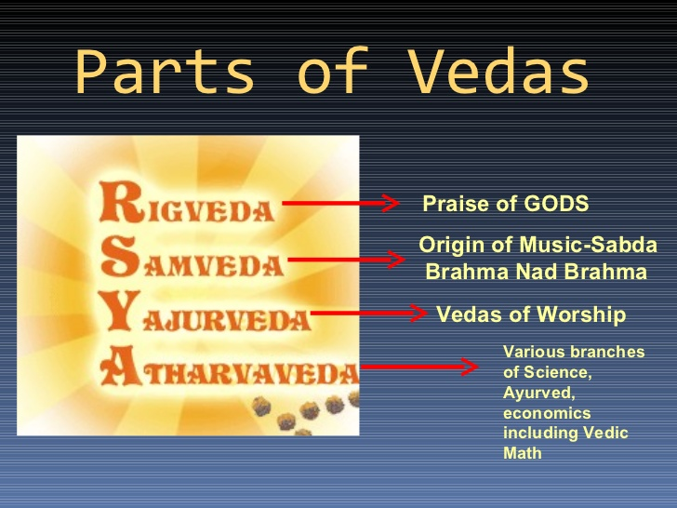
Vedas: Sacred Writings of Hinduism

Slide 3
Contribution of Vedic Times
Epics : Ramayan and Mahabharat
  Ramayan was written by Saint Valmiki
  Mahabharat was written by Saint Vyas
Yoga
  Yoga sutras compiled by Sage Patanjali
Ayurveda: Ayurvedic medicine is another form of medicine
Vedic Math
The world’s first University was established in Takshila
Nalanda was one of the world’s first residential universities

Slide 4
An Example of Vedic Math
Example 1
14 x 17, here base of both the numbers are the same, ie. 10. The first number is 4 more than 10 and the second is 7 more than 10. For convenience we call these as the deviations. Hence the deviations of 14 and 17 from 10 are 4 and 7 respectively.
Step 1: Add the deviation of one number with the other number.That means; either
14 + or 17 +
7 4
21 21
in both case it the same answer 21.
Step 2: Since the base is 10 multiply the above sum with 10.
21 x 10 = 210
Step 3: Multiply the deviations.
4 x 7 = 28
Step 4: Add the answers in Step 2 and Step 3.
210 +
28
238
So we got the answer
14 x 17 = 238
Reference: http://www.mathsmagic.in/vedic-maths--problems.html

Slide 5
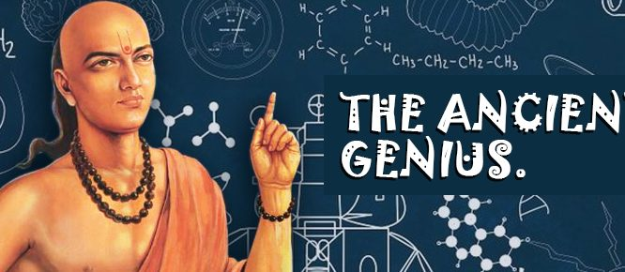

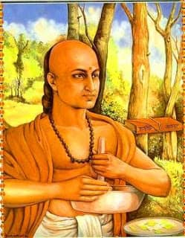

Contribution of Vedic Times
Aryabhatta – great mathematician
Kalidas - Poet
Charak – Physician who contributed to Science of Ayurveda
Chanakya - pioneer of the field of political science and economics in India

